Slide 1
Securing understanding of multiplication with fractions
Arithmetic procedures with fractions

Slide 2
how to use Oak lessons

Slide 3
I can multiply unit, non-unit and improper fractions.

Slide 4
A product is the result of two or more numbers multiplied together.
An operation is commutative if the values it is operating on can be written in either order without changing the calculation.
Prime factors are the factors of a number that are, themselves, prime.

Slide 5

Securing understanding of multiplication with fractions
Comparing products
Multiplying two or more fractions

Slide 6



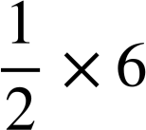
Comparing products
Lucas has a piece of material, which is 6 metres long and 1 metre wide.
What is the area of Lucas’ material?
6 m
1 m
1 × 6 = 6 m²
I need to cut my material into two long strips.
But, half of 6 is 3 and when you multiply a number it should get bigger.
Lucas
What calculation will represent the area of Lucas’ new strip?
Sam

Slide 7
Comparing products
We will take a look at what Sam said.
When you multiply a number it should get bigger.
Sam
Will the product of two numbers always be greater than either of those numbers?
Can you think of any pairs of numbers when that is not the case?

Slide 8
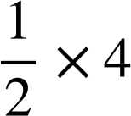
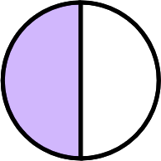
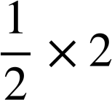
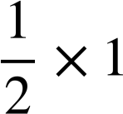

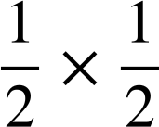

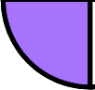
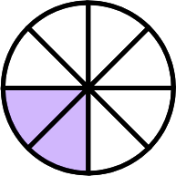
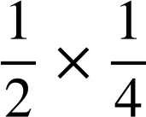

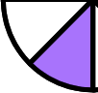
Comparing products
Let’s look at the following:
When did the products start being less than one half?
2
÷ 2
÷ 2
1
÷ 2
÷ 2
When we started multiplying by a number less than one.
÷ 2
÷ 2
÷ 2
÷ 2

Slide 9
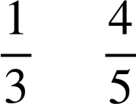
Comparing products
The product of two numbers where one number is between zero and one, will give a product less than the larger number.
E.g. 0.04 × 5 < 5
5 × < 5
The product of two numbers where both are between zero and one, will give a product less than either of the numbers.
E.g. 0.04 × 0.5 is less than both 0.04 and 0.5
× is less than than both and

Slide 10
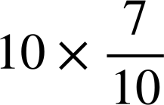
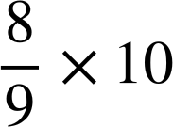
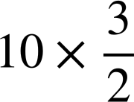
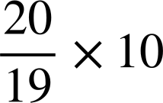
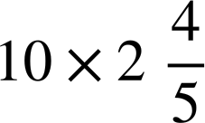
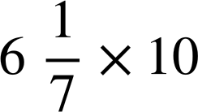
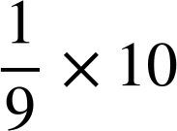
Comparing products
Sort the following into the correct group.
Less than 10
Greater than 10

Slide 11
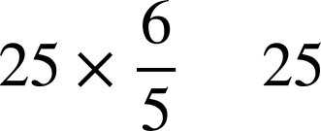
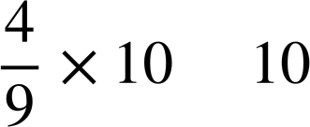
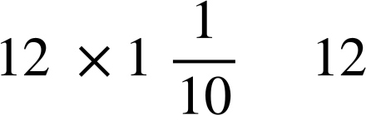
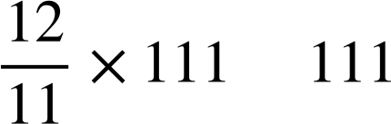
Comparing products
Use the symbols < and > to complete the following:
>
<
>
>

Slide 12

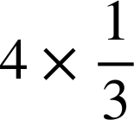
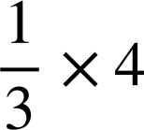

Comparing products
What is the same and what is different about these two calculations?
4 ‘lots of’
1 | 1 | 1 | 1
of 4

Slide 13
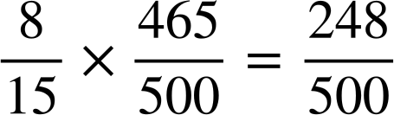
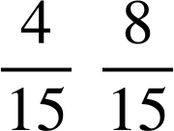
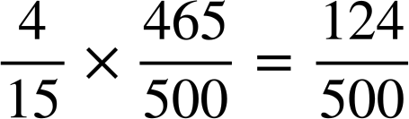
Comparing products
Lucas and Sam have been given this fact from their teacher.
So, it must be half of .
So you were right.
We know that is half of .
I know that
How did you do that so quickly?
Lucas
Sam

Slide 14
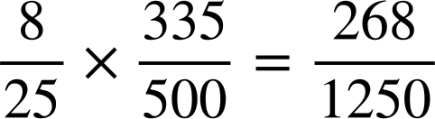
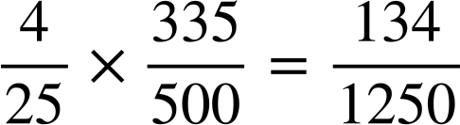
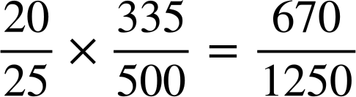
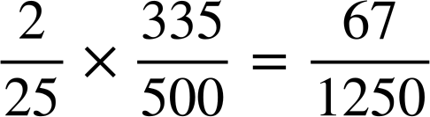
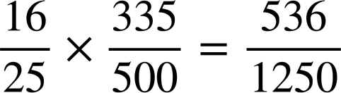
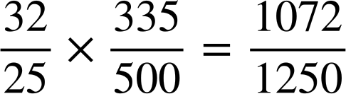
Comparing products
Write down as many different products as you can using this fact.
E.g.
How did I find this one?
I found the sum of and .
Why did I find the sum of those?
As they were the products for and .

Slide 15
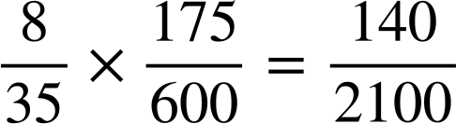
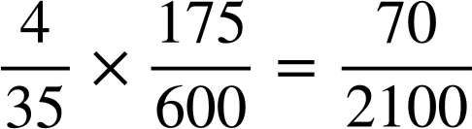

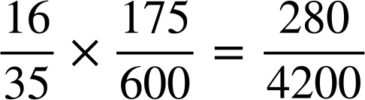
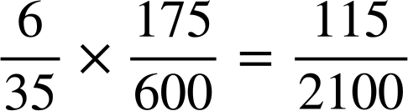
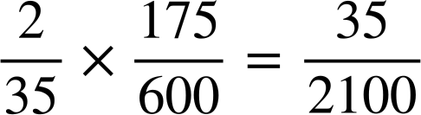
Comparing products
Given that which of the following are true?

Slide 16
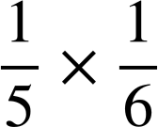
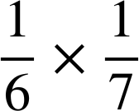
Comparing products
Is it possible to tell which of the following has the greater product without calculating an answer?
>
If we drew out an area model for each they would both have one part shaded.
Which product would the whole be divided into smaller parts?
because it has more parts, so each part will be smaller.

Slide 17
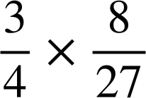
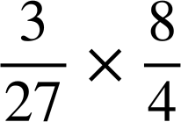
Comparing products
Is it possible to tell which of the following has the greater product without calculating an answer?
=
What do you notice about the numerators of each product?
They are the same.
What do you notice about the denominators of each product?
They are the same.
Therefore, they must be equal.

Slide 18
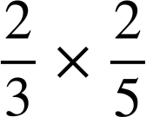
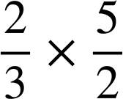
Comparing products
Is it possible to tell which of the following has the greater product without calculating an answer?
<
Both calculations use
The 1st calculation multiplies by which is less than one.
Meaning the product will be smaller than .
The 2nd calculation multiplies by which is greater than one.
Meaning the product will be greater than .

Slide 19
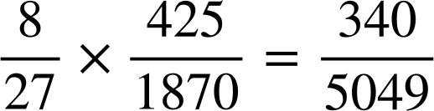
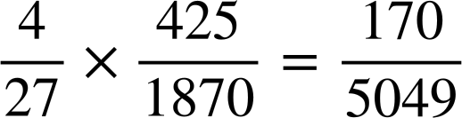
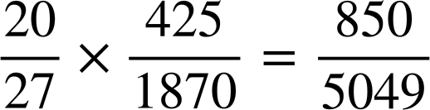
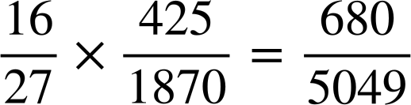
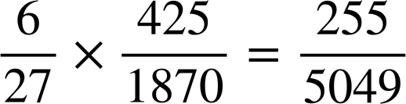
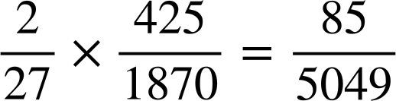

Comparing products
Use this fact to answer the following questions:
a)
b)
c)
d)
e)
f)

Slide 20



Comparing products
2) Without calculating, decide which is the greater product in each pair.
a)
b)
c)
d) Write the six products in order from smallest to largest.

Slide 21
Comparing products
Use this fact to answer the following questions:
a)
b)
c)
d)
e)
f)

Slide 22
Comparing products
2) Without calculating, decide which is the greater product in each pair.
a)
b)
c)
d) Write the six products in order from smallest to largest.
=
>
<
=

Slide 23
Securing understanding of multiplication with fractions
Comparing products
Multiplying two or more fractions

Slide 24




Multiplying two or more fractions
Earlier we looked at these two calculations.
What was the product as an improper fraction?
Therefore,
How does this link to our generalisation that: ?
Any integer can be written as fraction with a denominator of 1.

Slide 25

Multiplying two or more fractions
Calculate:

Slide 26


Multiplying two or more fractions
Lucas and Sam are calculating
Lucas’ workings:
Sam’s workings:
Lucas
What is the same and what is different about their methods?
Their methods are the same until then Lucas simplified and then converted the improper fraction to a mixed number and Sam changed it to a mixed number and then simplified.
Sam

Slide 27


Multiplying two or more fractions
Calculate:
Calculate:

Slide 28



Multiplying two or more fractions
Lucas & Sam are now calculating
Lucas’ method:
Sam’s method:
Lucas
Sam
What is the same and what is different about their methods?
They have both got an answer of , Lucas multiplies and then simplifies and Sam uses factors pairs to simplify first.

Slide 29

Multiplying two or more fractions
Why might finding factors of the numerators and denominators be useful here?

Slide 30

Multiplying two or more fractions
Lucas and Sam are thinking about which factor pairs help them to complete this calculation:
I’m going to use 8 for 16 and 40.
I’m going to use 4 for 16 and 40.
Lucas
Sam
Whose method do you think will be most efficient?
Let’s take a look.

Slide 31

Multiplying two or more fractions
Lucas’ method:
Sam’s method:
Whose method was most efficient?
Lucas’ method was more efficient.
Why was it more efficient?
He used the HCF of 16 & 40.

Slide 32


Multiplying two or more fractions
Lucas and Sam are now looking at this calculation:
Lucas’ method:
Sam’s method:
Lucas
Sam
Whose method do you think is most useful for completing the multiplication?
I think that Sam’s method is most useful.
What do you notice about Sam’s method?
They have written each number using its prime factors.

Slide 33



Multiplying two or more fractions
Let’s take a look at why Sam’s method is more useful.
Lucas’ method:
Rewrite the numerator and denominator with the common factors first.
Sam’s method:

Slide 34
Multiplying two or more fractions
Calculate
Calculate

Slide 35

Multiplying two or more fractions
Use the most efficient method to answer these questions.

Slide 36
Multiplying two or more fractions
Use the most efficient method to answer these questions.

Slide 37


Securing understanding of multiplication with fractions
The product of two numbers where one number is between zero and one, will give a product less than the larger number.
The product of two numbers where both are between zero and one, will give a product less than either of the numbers.
Any integer can be written as fraction with a denominator of 1.
Factors can be used to make the multiplication of fractions more efficient. E.g.

Slide 38

© Oak National Academy 2023.
Produced in partnership with Mathematics in Education and Industry.
Licensed on the Open Government Licence v3.0, except where otherwise stated. See Oak terms and conditions.

